Slide 1

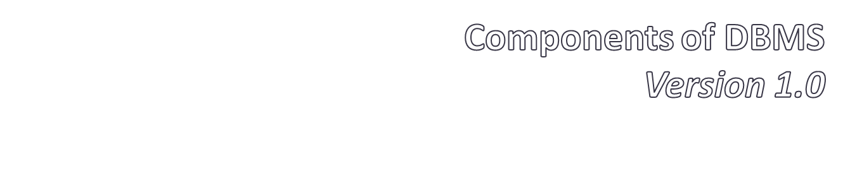

Slide 2

Models
Hierarchical model
Network model
Relational model
Entity- Relationship model
Object Relational model

Slide 3

2. A query language
allow users to interactively interrogate the database, analyse its data and update it according to the user privileges on data
so, you can say query language actually provides
Analysis on data
Interrogation on data
Security on data

Slide 4
Transaction Mechanism
Transaction is a collection of several operations on the Database appears to be a single unit. It provides ACID property.
In case of database systems, ACID stands for
Atomicity
Consistency
Isolation and
Durability

Slide 5
Atomicity
It is the ability of the DBMS that ensures either all of the transactions take place or none of them take place!
Kind of weird, huh? Well, let me give an example. If a bank account is debited, another bank account must be credited- that is called atomicity!

Slide 6

Transaction to transfer $50 from account A to account B:
  1. read(A)
  2. A := A – 50
  3. write(A)
  4. read(B)
  5. B := B + 50
  6. write(B)
Atomicity requirement
  if the transaction fails after step 3 and before step 6, money will be “lost” leading to an inconsistent database state
    Failure could be due to software or hardware
  the system should ensure that updates of a partially executed transaction are not reflected in the database

Slide 7
Consistency
Every database has some rules according to the organization to which it belongs. This property ensures that the databases are in legal state after a transaction takes place.
For example, if a bank says that its client’s account balance can never be negative, then no such transaction will take place that makes a balance negative.

Slide 8

Transaction to transfer $50 from account A to account B:
  1. read(A)
  2. A := A – 50
  3. write(A)
  4. read(B)
  5. B := B + 50
  6. write(B)
Consistency requirement in above example:
  the sum of A and B is unchanged by the execution of the transaction
  A transaction must see a consistent database.
  During transaction execution the database may be temporarily inconsistent.
  When the transaction completes successfully the database must be consistent
    Erroneous transaction logic can lead to inconsistency

Slide 9
Isolation
This property ensures that no other operation can intervene the transaction operation.
Although multiple transactions can execute concurrently in the database, database systems must provide mechanisms to isolate one transaction from the effects of other concurrently executing transactions. This property is called isolation.

Slide 10

Isolation requirement — if between steps 3 and 6, another transaction T2 is allowed to access the partially updated database, it will see an inconsistent database (the sum A + B will be less than it should be).
T1 T2
  1. read(A)
  2. A := A – 50
  3. write(A)
  read(A), read(B), print(A+B)
  4. read(B)
  5. B := B + 50
  6. write(B
Isolation can be ensured trivially by running transactions serially
  that is, one after the other.
However, executing multiple transactions concurrently has significant benefits, as we will see later.

Slide 11
Durability
This property ensures that once a transaction takes place, it cannot be undone.
when an account to account transfer takes place, after completion, it should notify the user that transaction successfully done and you cannot rewind that!

